Slide 1
Principles of Epidemiology for Public Health EPID 600
Course Overview&
Measures of Occurrence
Dr. Karin Yeatts
January 15, 2019

Slide 2
Welcome!
Introductions
Syllabus/Course Structure
Course Learning Objectives & Expectations
What is Epidemiology?
Measures of Occurrence

Slide 3
Teaching Team
Doctoral Students in the Department of Epidemiology
Rebecca Bloch
Amber Hall
Each TA has ~42 students
Lab sessions have ~22 students
Dr. Lorraine Alexander-co-instructor, Sakai Expert

Slide 4
Syllabus
Cooperative learning responsibilities
Team based learning 50%
Labs, Team project
Honor system
Diversity
Time commitment
Assignments, due dates, & grading policies

Slide 5

Assignments
 | Indiv. | Team | % of Grade
Individual Data Analysis Exam |  |  | 30
Quizzes (4) (drop lowest) |  |  | 15
Participation |  |  | 5
Lab assignments (12) (drop lowest) |  |  | 20
Team Project (Final Exam Pres., Thursday Dec 14 4-7pm Attendance Mandatory) |  |  | 30
Total |  |  | 100

Slide 6
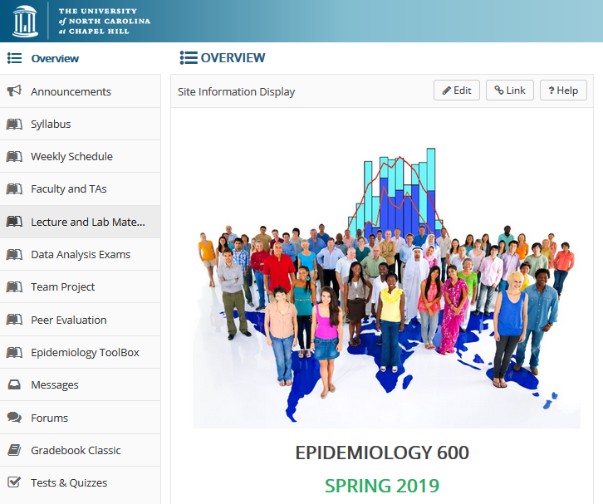
Sakai Course Website Organization

Slide 7
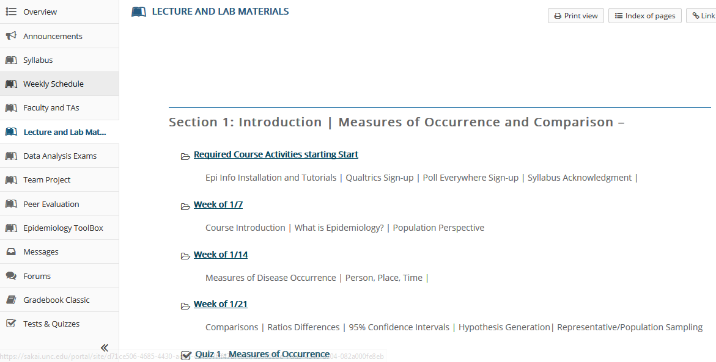
Sakai Course Website Organization

Slide 8
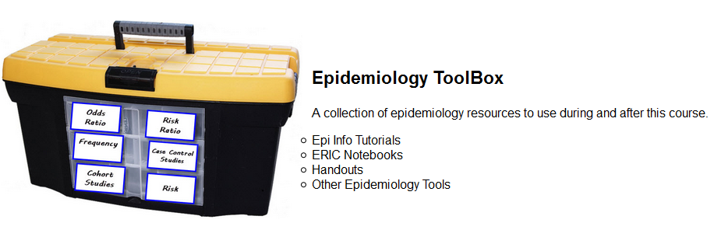
Epidemiology Toolbox

Slide 9
Course Learning Objectives
Explain the importance of epidemiology for informing scientific, ethical, economic and political discussion of health issues.
Describe a public health problem in terms of person, place, and time.
Apply the basic terminology and definitions of epidemiology.
Calculate basic epidemiology measures.
Identify key sources of data for epidemiologic purposes.
Evaluate the strengths and limitations of epidemiologic reports.
Comprehend basic ethical and legal principles pertaining to the collection, maintenance, use and dissemination of epidemiologic data.
Draw appropriate inferences from epidemiologic data.
Identify the principles and limitations of public health screening programs.

Slide 10
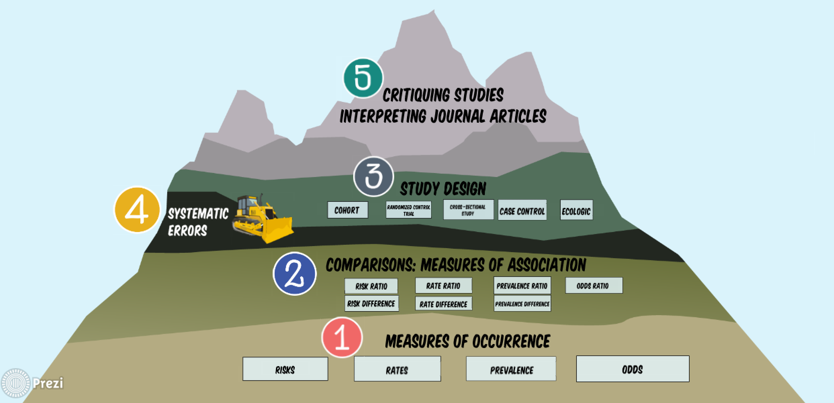
Appendix-Graphic Syllabus

Slide 11
Course Expectations
Participate and engage in lecture and weekly labs
Prioritize team work with your team members
Complete all team and individual assignments on time

Slide 12
Poll Everywhere

Slide 13
What is epidemiology?
The study of the distribution and determinants :
Of disease and
Of risk factors/exposures
…in populations.
Determinants include the geophysical, biological, behavioral, social, cultural, economic, and political factors that influence health.
Notes:
FOR OUR CLASS:

Slide 14

Proximal and distal causes, Upstream and downstream thinking, Socio-ecological Framework
Notes:
Pu
Scott A, Ejikeme CS, Clottey EN, Thomas JH. (2012). Obesity in sub
-
Saharan Africa: development
of an ec
ological theoretical framework. Health Promotion International; 28(1):4
-
16.
Viruell
-
Fuentes EA
, Miranda PY, Abdulrahim S. (2012). More than culture: Structural racism,
intersetionality theory, and immigrant he
alth
. Social Science and Medicine
,
74:2099
-
2106
t in EXAMPLES

Slide 15
Disease “Distribution”
How does disease occurrence vary by “person, place, and time”?

Slide 16
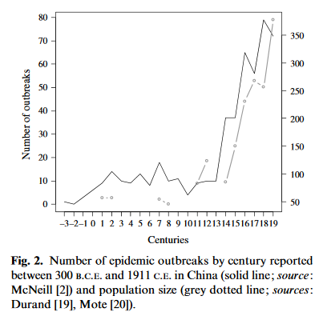
Epidemic and population patterns in the Chinese Empire (243 BCE to 1911 C E): quantitative analysis of a unique but neglected epidemic catalogue Morabia 2009
Notes:
Epidemic and population patterns in the Chinese Empire
(243
B
.
C
.
E
. to 1911
C
.
E
.): quantitative analysis of a unique butneglected epidemic catalogue

Slide 17
What factors make individuals sick? Vs. What factors make populations sick?

Slide 18
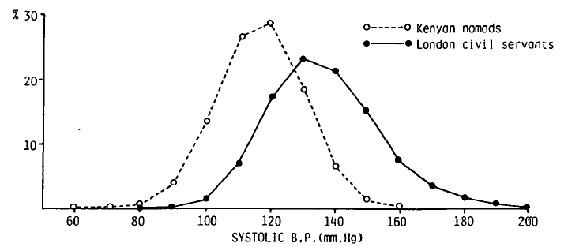
Population Perspective
Distributions of systolic blood pressure in middle-aged men in two population (Rose 1985)

Slide 19
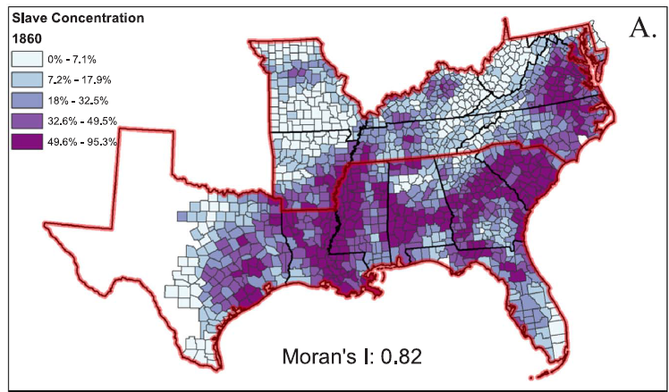
Kramer MR, Black NC, Matthews SA, James SA. The legacy of slavery and contemporary declines in heart disease mortality in the U.S. South. SSM Popul Health. 2017 Dec;3:609-617.

Slide 20
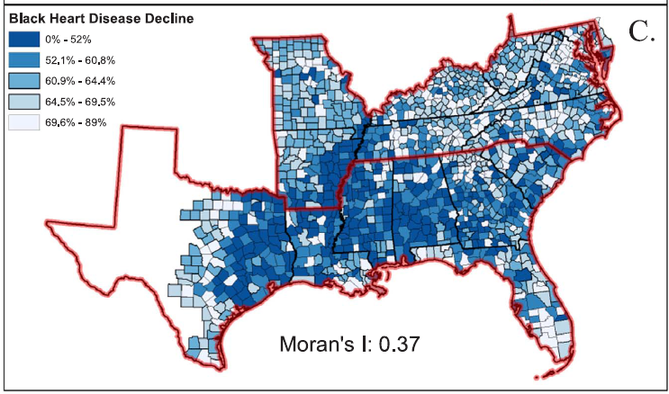
Panels C: Age adjusted, percent decline in mortality from all diseases of the heart between 1968 and 2014 for Blacks. Source: National Center for Health Statistics.”

Slide 21
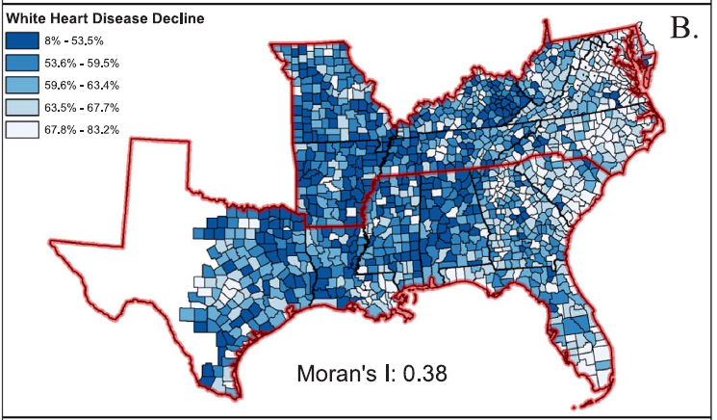
Panels B Age adjusted, percent decline in mortality from all diseases of the heart between 1968 and 2014 for Whites. Source: National Center for Health Statistics.”

Slide 22
Population Perspective & Public Health’s Mission
Population perspective
Describe the patterns of disease and health status in population
Identify the underlying societal causes of patterns
Develop community-based interventions targeting environmental, economic, social and cultural determinants of disease
Build evidence-based health policy and laws
Public health mission
Assure the conditions in which people can be healthy
Develop organization community programs aimed at promoting good health
Function through laws, mass media

Slide 23
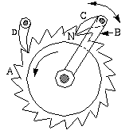
The Biomedical Perspective
Study of…
Individual risk factors
Mechanisms of disease
Proximal causes – directly related to disease onset
What are biological mechanisms that lead to the development of disease?
Changes in blood pressure, lung function, heart rhythm, circulating inflammatory markers, etc.

Slide 24
Basic, Clinical, and Population-based Research
 | Basic | Clinical | Population
What, who is studied | Cells, tissues, animals in laboratory settings | Sick patients who come to healthcare facilities | Populations, communities
Research goals | Understand disease mechanisms | Improving diagnosis and treatment | Prevention of disease, promotion of health
Examples | Toxicology, immunology | Internal medicine, pediatrics | Epidemiology, environmental health science
Aschengrau p. 5

Slide 25
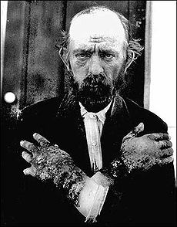
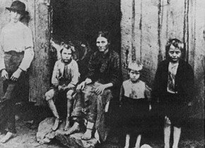
“Joseph Goldberger: An Unsung Hero of American Clinical Epidemiology”
Pellegra
Characterized by 4 D’s
Dermatitis
Diarrhea
Dementia
Death
Cause?
.
Elmore JG, Feinstein AR.
Ann Intern Med. 1994 Sep 1;121(5):372-5

Slide 26
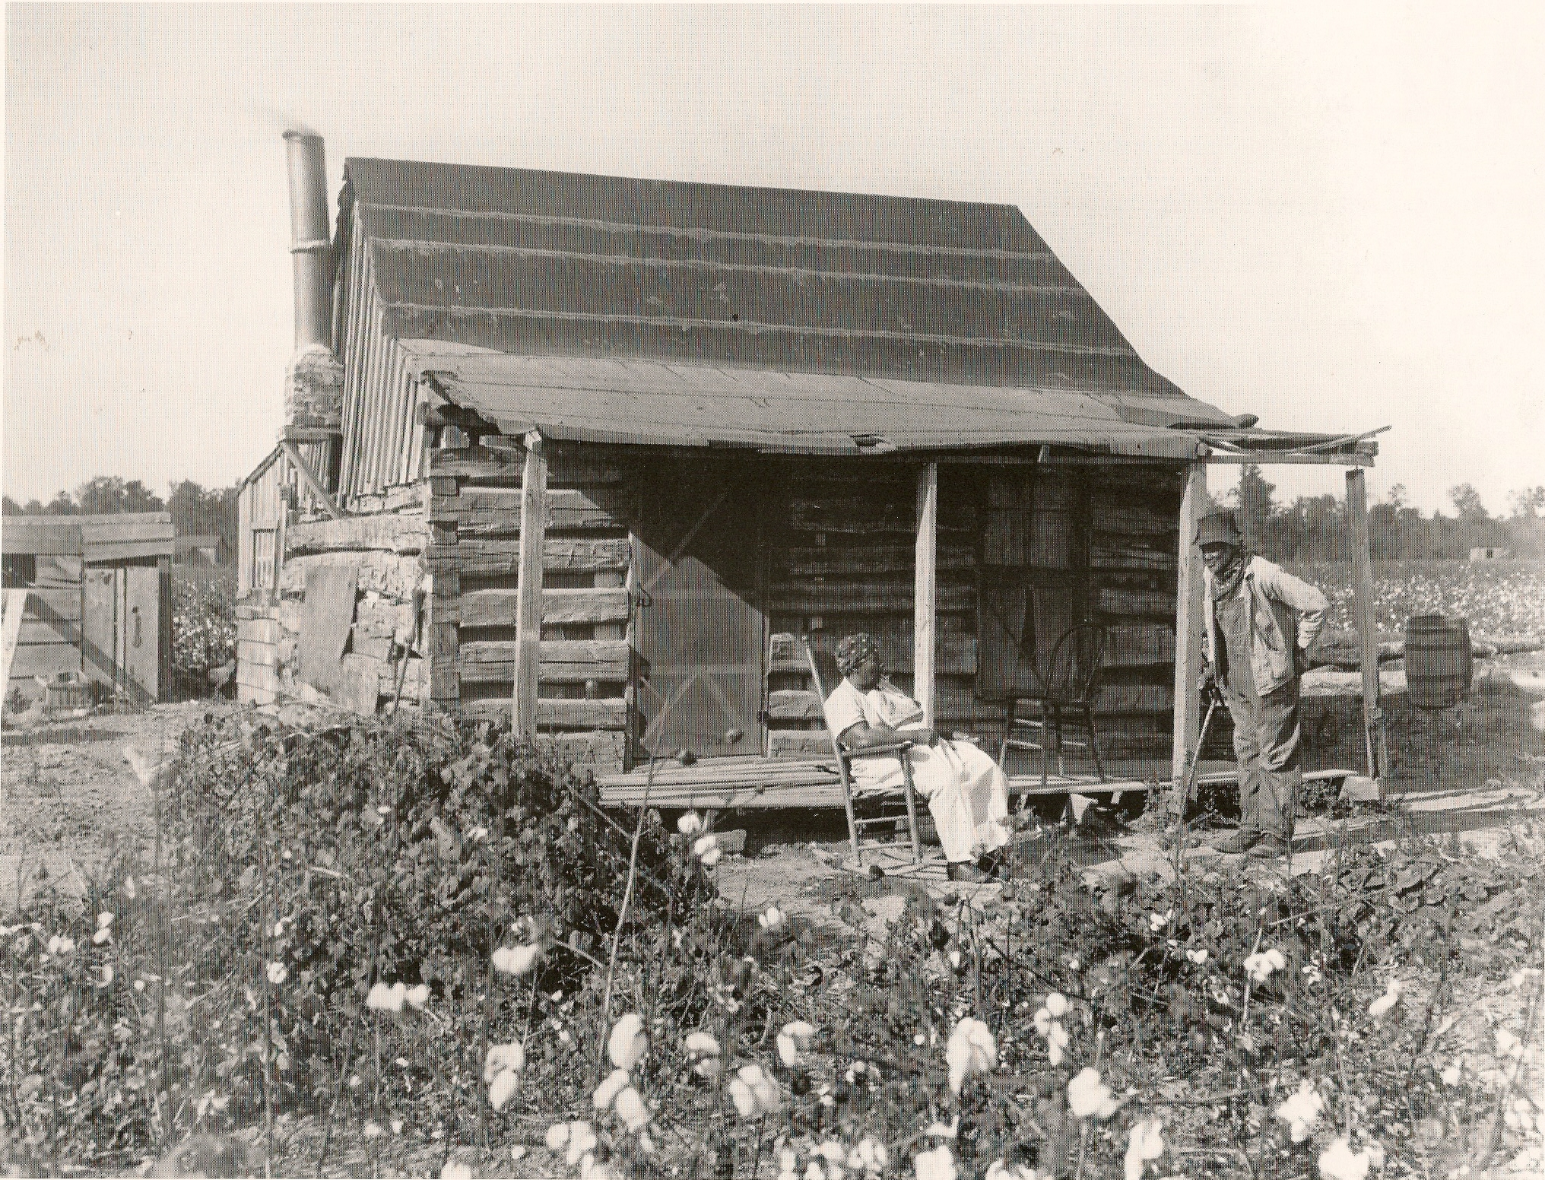
Sharecroppers’ plague
.
Notes:
Pellagra rapidly spread after that date, becoming particularly common in the Southern states, among the poor, and especially among sharecroppers

Slide 27
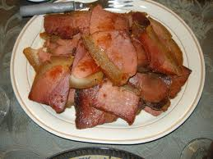

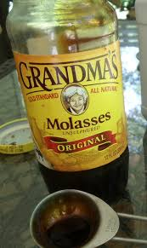
3 Ms
Notes:
Tenants, therefore, usually subsisted on the “three M's” available from the landowners' stores: meat (fatback), meal (corn meal), and molasses

Slide 28
Goldberger
Used epidemiologic concepts
Person, place time
Disease frequencies
Studies in populations
Human study ethics
Causality

Slide 29


Slide 30
Measures of Disease Occurrence
EPID600

Slide 31
Course Objectives
Explain the importance of epidemiology for informing scientific, ethical, economic and political discussion of health issues.
Describe a public health problem in terms of person, place, and time., and time.
Apply the basic terminology and definitions of epidemiology.
Calculate basic epidemiology measures.
Identify key sources of data for epidemiologic purposes.
Evaluate the strengths and limitations of epidemiologic reports.
Comprehend basic ethical and legal principles pertaining to the collection, maintenance, use and dissemination of epidemiologic data.
Draw appropriate inferences from epidemiologic data.
Identify the principles and limitations of public health screening programs.
Communicate epidemiologic information to lay and professional audiences.
Apply concepts, methods, and tools of public health data collection, analysis and interpretation, and the evidence-based reasoning and informatics approaches that are essential to public health practice.

Slide 32
Class Objectives
Distinguish between prevalent and incident cases
Calculate and interpret common epidemiologic measures of disease occurrence
Prevalence
Risk
Rate
Odds
Calculate person-time

Slide 33
=
# incident cases ––––––––––––––––––––––––––––––––––– # at-risk study population at start of study
Risk (R)
# incident cases –––––––––––––––––––––––––––––––– Person-time at risk during study period
Rate (IR)
=
# prevalent cases ––––––––––––––––––––––– # total study population
Prevalence (P)
=
# cases ––––––––––––––––––––––– # non cases
Odds (O)
=
33

Slide 34
Outline for Today
Lecture, part 1
Tools for communicating risk
Lecture, part 2
Data Analysis, Class Example
Dataset
Computing Risks, Rates, Prevalence
self assessment

Slide 35
How do we know if there is a public health problem?
How do we identify if there is a public health problem?
Describe disease or health occurrence
Is disease occurrence increasing, decreasing, or staying the same?
Is disease occurrence higher in one group than another?

Slide 36
Public health-related examples
Gun Violence
Health Insurance/Health Care
Health Disparities
Rural health

Slide 37
Measures of Occurrence
Prevalence, Risk, Rates, Odds
Three components:
Numerator-Number of people with outcome-”cases”
Denominator-population (sometimes study sample) that gives rise to cases
Time period that population is followed

Slide 38
Briefly..
Prevalence-how much disease is there at one moment, or one period, of time?
Risk-how much disease over time, and I can track everyone in my population or study?
Rate-how much disease over time-and people are moving in and out of my study..

Slide 39
=
# incident cases ––––––––––––––––––––––––––––––––––– # at-risk study population at start of study
Risk (R)
# incident cases –––––––––––––––––––––––––––––––– Person-time at risk during study period
Rate (IR)
=
# prevalent cases ––––––––––––––––––––––– # total study population
Prevalence (P)
=
# cases ––––––––––––––––––––––– # non cases
Odds (O)
=
Notes:
The denominators for each formula differ from each other.
Risk has the at risk study population at the start of the study period, while rate uses person time at risk during the study period.
Prevalence uses the total study population as the denominator, and for odds, the non cases form the denominator.

Slide 40
Types of Populations
 | Synonyms | Key Element | Example
Dynamic | Open | Membership is based on a condition and is transitory Commonly defined by geographic area and time period | Residents of Recife, Brazil
Stationary | Closed, Fixed | Membership is based on an event and is permanent | Individuals exposed to a natural or human-made disaster

Slide 41
Dynamic or stationary population?
Pregnant women
Individuals subject to particular laws
Individuals who lived through Hurricane Harvey
Survivors of the atomic bomb blast in Hiroshima

Slide 42
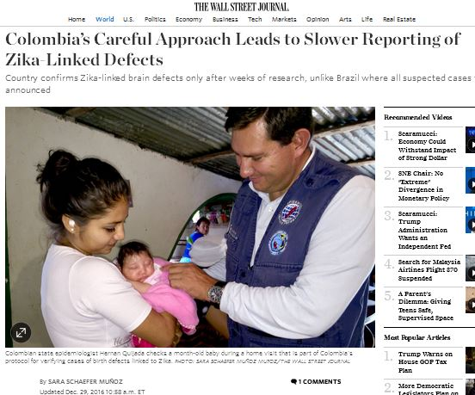
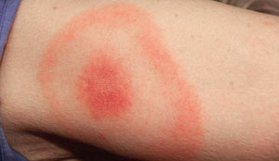
What is a “case”?
Our numerators…
How do we define a case? And what are the consequences of this definition?
Examples
HIV
Microcephaly
Tick borne disease-Lyme’s disease

Slide 43
Incident Cases
Prevalent Cases
New cases
Individuals who change in status over a specified period of time
Calculating risks, rates
All cases
Individuals with outcome of interest, regardless of when diagnosed
Calculating prevalence

Slide 44


Incident cases
Prevalent cases
Recovered
Death
Notes:
…

Slide 45
What if your case definition changes?
Your measure of occurrence will change too, (as this changes your numerator).
Consider Obesity and overweight
Only overweight
Only obese
combined overweight and obese

Slide 46

Why is prevalence important?
Approximately 12% of the world’s population is obese.
Quantifies the burden in a population
Useful for planning health services

Slide 47

# of people with the health outcome
(prevalent cases)
# of people in the total population
May 1, 2012

Slide 48
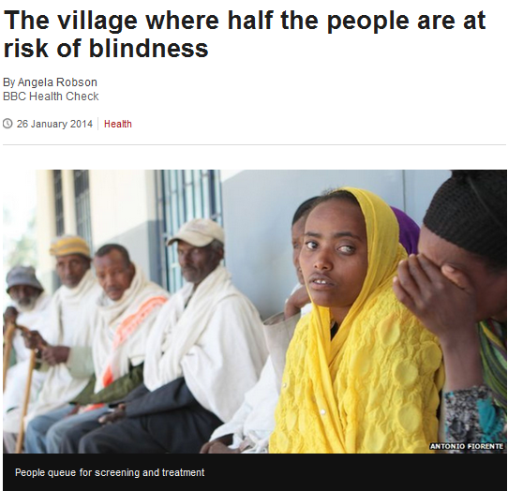
Risk
http://www.bbc.co.uk/news/health-25877285

Slide 49
Calculating Risk
Numerator: Incident cases (i.e. new cases identified during study follow-up)
Denominator: Study population at risk at beginning of follow-up
# incident cases Risk = ------------------------------------------ total # at-risk individuals

Slide 50
Example: Risk
Risk of HIV in North Carolina in 2010
= 19.2 cases per 100,000 population
Change in status from non-HIV infected to HIV infected in 2010
Limited to new [incident] cases
Denominator includes only NC residents without HIV at the beginning of 2010

Slide 51
Example Tool for Communicating Risk
Statin Decision Aid- Mayo Clinic

Slide 52
What if…
What if some, for example 50%, of your study subjects drop out of the study?
Because they move away
Because they had some other illness
Compensation was reduced or eliminated
Study took too much time, they were busy.

Slide 53
Rate (IR)
Number of new cases that develop per unit of person-time at risk over a specific amount of follow-up time
Denominator is constantly adjusted for losses and additions

Slide 54
What is person-time?
Think of it as “Time at risk”
The time “at risk” that study participants contribute while enrolled in study
Contributed only by people “at risk for” the outcome
Units can be person-years, person-months, person-days, etc.
Units are interchangeable (e.g. 10 person-years = 120 person-months)

Slide 55
Person-time/ “Time at risk” Assumed to be exchangeable units
100 people
Years
0
1
2
3
4
5
100 people followed 5 years = 500 person-years
500 people
Years
0
1
2
3
4
5
500 people followed 1 year = 500 person-years
Exchangeability assumption: probably reasonable in most settings, but should never be taken for granted

Slide 56
Person-Time-when does it stop?
When does a person stop contributing person-time at risk?
when a person stops being “at-risk”
Examples:
Death
When they develop the disease under study
Moving out of the study population
Lost to follow-up

Slide 57
Different methods to calculate person-time
Method A:
Add up the time that each person is at risk (Sum time for each person). Useful when you have the individual records for time under observation for individuals; know timing of disease
Method B: NOTE: what is done MOST of the time
Multiply the average size of the population at risk by the length of the time interval (Take an average of time)
Useful when you have population estimates, but no data on individuals through time (census data)
Examples:Cancer Statistics 2013 Slide Presentation (PPT) - American ...
www.cancer.org/acs/.../acspc-041647.pptx
Notes:
57

Slide 58
Assume
Assume a stationary population
the use of census data in the denominator
Assume everyone in the denominator is “at risk”-works well when disease of interest is rare (less than 10% of the population)
Benefits-
Much less expensive! It’s costly to track people.
Works well when data available (in some geographic locations)

Slide 59
Diagram of person time in a closed cohort
S1 -----------------------------------------------------------------
S2 -----------------------------------------------------------------D
S3 ------------------------------------------------------------------
S4 ------------------------------------------------------------------D
S5 ------------------------------------------------------------------
Years 0 1 2 3 4 5 6
Each person contributing same amount of Person-Time
6 years X 5 subjects=30 person-years
Numerator=2 cases
Denominator=30 person-years
Rate =2/30 =0.0667 cases/person years= 6.67 per 100 p-yrs

Slide 60
Diagram of person time in a dynamic or open cohort Method A – Sum time for each person
S1 ----------------------X
S2 ----------------------------------------------------------------------------D
S3 ---------------------- -----------D - - - - - - - -
S4 -------------------------------------------------------
S5 -------------------------------------------L
Years 0 1 2 3 4 5 6 7
X = death; D = disease; L = lost to follow-up
Calculate rate for 7 years of follow-up:
Numerator: 2 cases
Denominator: Total person-time = 2+7+3+5+4 = _ person-years
Rate: 2 case / 21 person-years = __
= __ cases per 100 person-years
= 2
= 7
= 3
= 5
= 4

Slide 61
Rate
# incident cases Rate = ------------------------------------------ total person-time at risk
Under specific assumption- when the incidence rate is relatively constant
Risk = Incidence Rate x Time

Slide 62
When do we prefer rates?
When the population is changing over time (i.e. dynamic population)
If the rapidity with which new events are occurring in the population is of interest

Slide 63
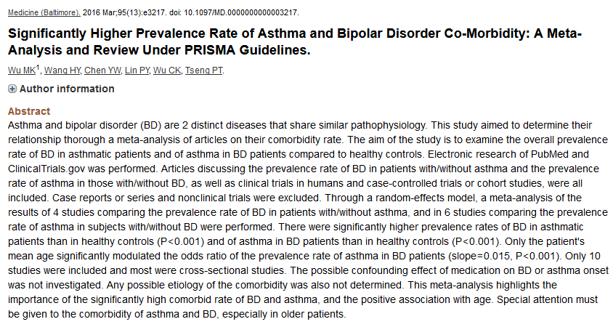
What’s wrong with this title and abstract?

Slide 64
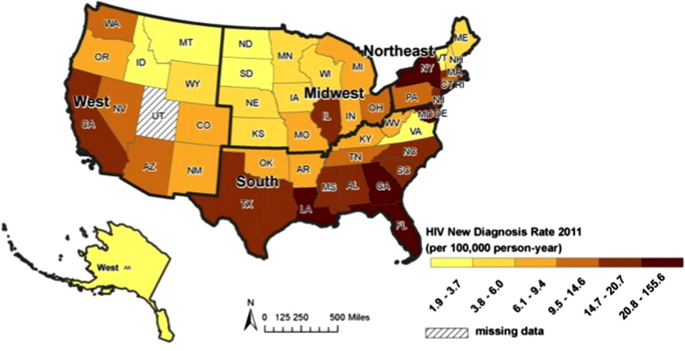
Rate Example
Incident (new) HIV diagnoses per 100,000 person-years
Reif et al. AIDS Care. 2013

Slide 65
Special cases
“Mortality Rate”- commonly used.
Morbidity Rate- commonly used.
“Prevalence rate”-is incorrect.
Rate Misnomers:
Response rate, case fatality rate, attack rate, prevalence rate
These are proportions, not rates

Slide 66
Unit conversions
0.00471 new cases per 1 person-yr
0.0471 new cases per 10 person-yrs
0.471 new cases per 100 person-yrs
4.71 new cases per 1,000 person-yrs
47.1 new cases per 10,000 person-yrs
471 new cases per 100,000 person-yrs

Slide 67
Example-Rates of HIV in Zambia
https://www.sciencedaily.com/releases/2018/01/180112151227.htm
A real rate..

Slide 68
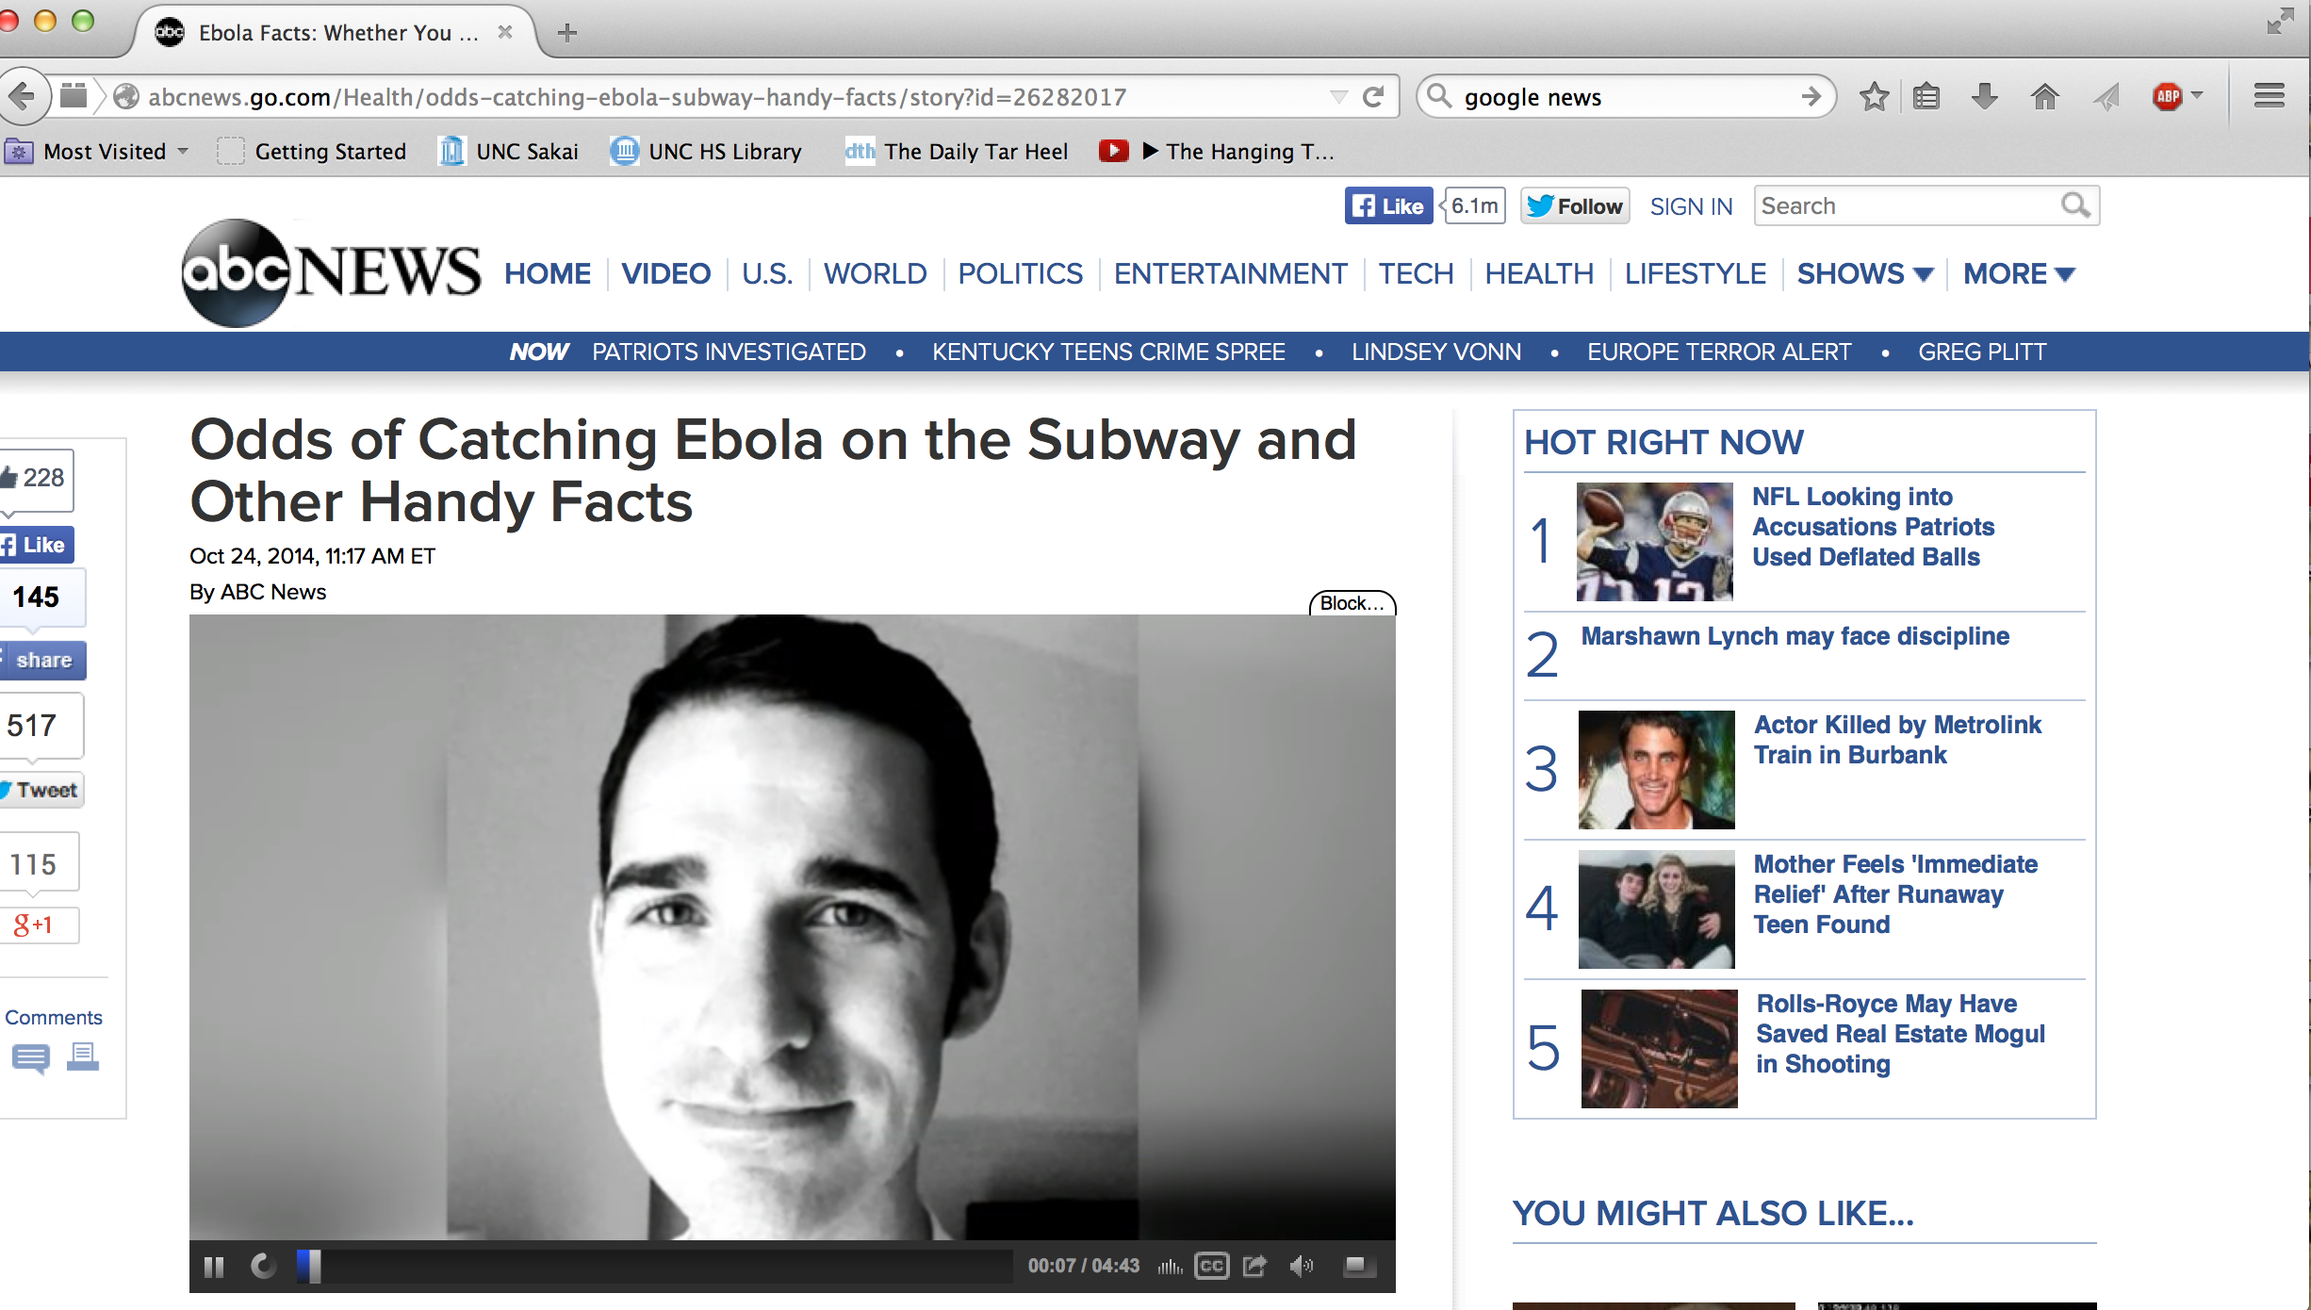
Odds
Used when meaningful prevalence, risk, and rate data are not available

Slide 69

Odds
Odds = (P/1-P), the probability of an event occurring divided by the probability of it not occurring. A risk is a probability.
Odds of an event = ratio of the probability that the event will occur, to the probability that it won't occur
Odds= # events or # cases
# non-events # of non-cases
Notes:
In statistics, we refer to odds as the ratio of the probability that an event (such as a health outcome) will occur to the probability that the event will not occur. Odds are sometimes used in epidemiology due to their convenient mathematical properties.

Slide 70
Examples: Odds
If the probability of an event (risk) is 0.20, the odds are 0.20/ (1-0.20) =
The probability of diabetes in a low income neighborhood is 5%; the odds of diabetes are 0.05/ (1-0.05) =
Out of 100 births, the probability of having a boy is 51% while the probability of having a girl is 49%. So the odds of having a boy born is 51/49=

Slide 71
What’s wrong with this abstract title?
J Affect Disord. 2017 Aug 15;225:227-233. doi: 10.1016/j.jad.2017.08.012
Exploration of comorbid obsessive-compulsive disorder in patients with bipolar disorder: The clinic-based prevalence rate, symptoms nature and clinical correlates. Jeon S¹, Baek JH¹, Yang SY¹, Choi Y², Ahn SW², Ha K³, Hong KS⁴.

Slide 72
Food Insecurity & Obesity
A recent study examined food insecurity and development of obesity. There were two groups of children in the study: 1) 17,623 food secure children contributing 292,763 person-years to the study, and 2) 531 food insecure contributing 8,692 person-years.
128 children were identified as obese in food secure group.
35 children were determined obese in the food insecure group. Average follow-up occurred for 16 years.
Calculate the risk and rate of obesity in the food insecure group.
Risk= 35/531 =
Rate=35/8692=

Slide 73
Practice Problem
In the previous example, obesity was defined as BMI >= to 30. If instead, we lowered the BMI cut point to 28, and found 63 more children who were included as cases, what would be the risk of obesity in the food insecure group be?
Risk =

Slide 74
What’s wrong with this abstract?
J Pediatr Nurs. 2017 Aug 19. pii: S0882-5963(17)30166-5. doi: 10.1016/j.pedn.2017.08.024. [Epub ahead of print] Social Determinants of Overweight and Obesity Rates by Elementary School in a Predominantly Hispanic School District.Santos R¹, Huerta G², Karki M³, Cantarero A⁴.
Abstract
OBJECTIVE:
This study analyzes the social determinants associated with the overweight or obesity prevalence of 85 elementary schools during the 2010-11 academic year in a predominantly Hispanic school district.
METHODS:
A binomial logistic regression is used to analyze the aggregate overweight or obesity rate of a school by the percent of Hispanic students in each school, selected school and neighborhood characteristics, and its geographical location.
RESULTS:
The proportion of Hispanic enrollment more readily explains a school's aggregate overweight or obesity rate than other social determinants or spatial location. Number of fast food places and the academic ranking of a school appear to slightly impact the aggregate prevalence rate. Spatial location of school is not a significant factor, controlling for other determinants.
CONCLUSIONS:
An elementary school's overall overweight or obesity rate provides a valuable health indicator to study the social determinants of obesity among Hispanics and other students within a local neighborhood.

